Slide 1
A Tale of Two Campaigns (One that was a success, one that failed, and why)
Mark Chilutti, CFRE
Magee Rehab Hospital- Jefferson Health

Slide 2
Today’s Topics
Understanding why the first campaign failed
What Campaign Readiness looks like
What a successful plan looks like
Crafting your story (case)

Slide 3
The importance of trained volunteer leadership
Why to create recognition/naming opportunities at the start
How to celebrate your success
The real impact of a successful campaign

Slide 4
About Magee Rehab Hospital
Founded in 1958 through the ultimate planned giving story
Treat people recovering from brain and spinal cord injuries, strokes, amputations, and other life changing injuries
Raise about $3 million per year

Slide 5
A magical little place at 16Th & Race Streets

Slide 6
The First Campaign
Pressure from the board to do a campaign
Wanted a large goal like $5 million+ (settled on $1 million)
Had a matching grant from the state for $1 million

Slide 7
4 Areas to Support
Cafeteria Renovations
Dialysis Center
Nurse Alert System
Ventilator Upgrades

Slide 8
Well, how did it go?
Only raised $436,000 from donors
One gift of $100,000
And even that took a lot of work
Eye opening and deflating

Slide 9
What we knew when we started
Couldn’t be the Ron & Mark show
Lacked volunteers to ask people for support
Had full board support, but not at high enough levels
Limited major gift prospects

Slide 10
What we learned along the way
Just because we need it we should not assume donors will be excited to fund it
Our board had a lot to learn about Magee, and the significant role philanthropy plays
We needed a strong volunteer campaign chair who could build a strong team of volunteers
We needed more qualified prospects

Slide 11
We just weren’t ready

Slide 12
What I learned along the way
I needed to build stronger relationships with donors
I needed to start asking donors to increase their giving, and it was time to build a major gift program

Slide 13
So how did we get ready?
Get to know our donors better
Have our donors get to know Magee better
Be better storytellers all year long
Increase stewardship efforts

Slide 14
Build trust and understanding
Train our board to share their story with others- they have to do more than just give
Recruited, trained, and built a team of volunteers that would ask people for money
A Chairman who was determined to be successful

Slide 15
How we backed into the campaign
2011 Humanitarian Award Dinner- what should we do with the proceeds?

Slide 16
Let’s build a Healing Garden!

Slide 17
Let’s build a few Healing Gardens
Can we also build an art therapy studio?
What about a spirituality center?
What about a patient gathering area….with a fireplace
All I can see is a brick wall…can we put glass in there instead?

Slide 18
Time to put the brakes on before we fail again!

Slide 19
Let’s do this right!
Determine the full scope of the project
Meet with stakeholders
Create a budget

Slide 20
Build and test a case
Determine naming opportunities and a robust donor recognition plan
Build out prospect lists at appropriate levels

Slide 21
Write/produce an effective case statement

Slide 22
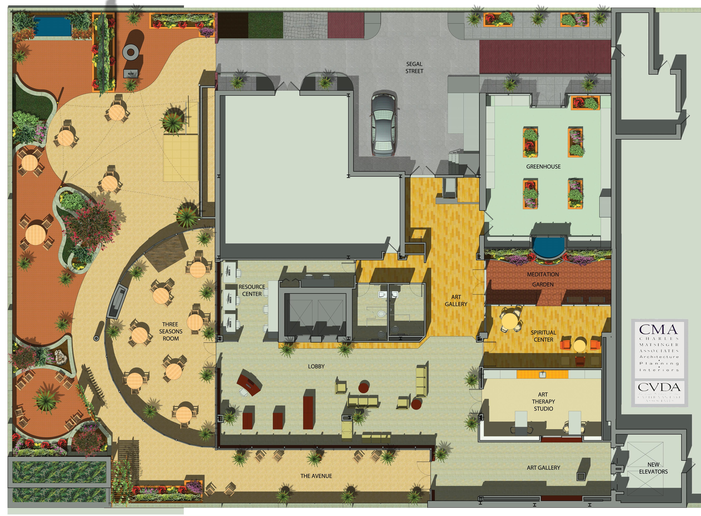

Slide 23
The Ingredients
Bright and colorful
What we are doing – paint a picture for them
Why we were doing it & the impact it would make
How they can get involved
Map insert and naming menu insert

Slide 24
The Secret Ingredient….
Have something that can appeal to everyone!

Slide 25
The Creative Therapy Center & Healing Gardens
5 Healing Gardens
6 accessible planter gardens
Art Therapy Studio
Spirituality Center (inside) & Meditation Garden (outside)
6 Glass “Windows to the City”

Slide 26
Indoor & Outdoor features
Patient Social Center (with electric fireplace)
City streetscape with curb cuts, different surfaces, a car, a ramp, and more!
Indoor greenhouse
A named “avenue” and a named “street”
Lots of casual space just to relax

Slide 27
How that helped us be successful
Wide appeal to different audiences
Tested well with board, staff & donors (ask for advice-get $$$)
Directed gifts to specific named areas, or just general support of the project
Easy to understand what each area was and how it would make an impact on our patients

Slide 28
Donor Recognition Wall Design

Slide 29
$5,000 minimum to be on the donor wall
Separate sections based on level of giving
Had a design to show as a part of the ask
Attractive looking as opposed to just boring engraved wood or brass plaques

Slide 30
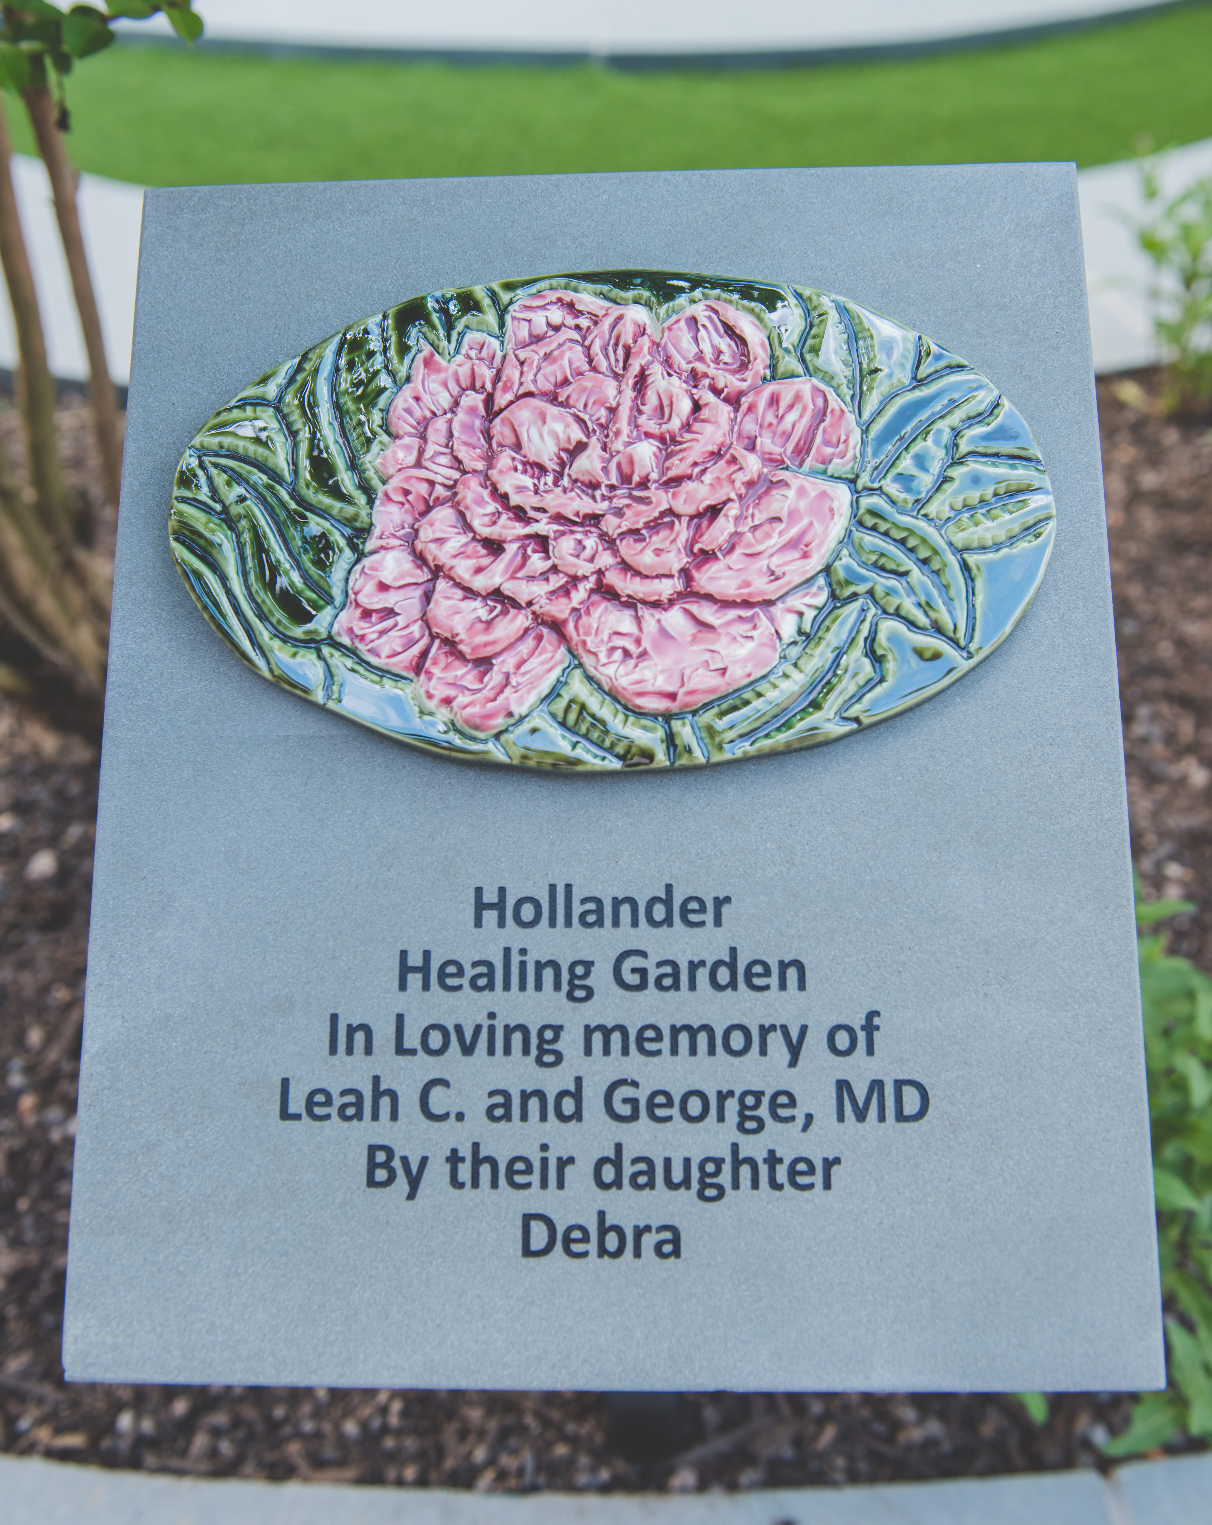
Plaques for Named Areas

Slide 31
Involved donors, prospects and staff in the design work
Contest to choose the 3 flowers on the plaques
Design fit with the project

Slide 32
We’re finally ready to go!
$4 million project
Half will be raised and half will come out of hospital operations
Volunteer leadership team was built and were the first to make pledges/gifts

Slide 33
Leading by example
$567,000 in commitments from 100% of the boards
$101,000 from physicians and executive leadership
Early major gift commitments secured from key donors
Successful staff campaign- committee included non-fundraising staff

Slide 34
Lots of momentum and excitement
Reception and open houses to share the plan
Hardhat tours during construction
Regular campaign steering committee meetings held, and updates shared with board and donors

Slide 35
Construction tour with donors

Slide 36
Sharing the plan with Staff and Guests

Slide 37
Getting closer to the finish line…
Project costs increased to $4.2 million
Largest donor to the campaign added $80,000 to his gift at the end
$2.15 million raised!!!

Slide 38
The final numbers
Largest gift $330,000
4 donors at $100,000
Our sweet spot was $15,000 to $25,000
Largest gift ever to Magee (to date)
Some foundation & corporate support

Slide 39
Time to celebrate with donors!
VIP Grand Opening Reception
Red carpet entrance in garage to elevator
Each named area ($15,000 and above) had a ribbon cutting
Recognition of top donors/campaign leaders with special gift
Guided tours and lots of pictures for donors

Slide 47
Let’s do it again!
Lunchtime ribbon cutting with former patients
Staff, patients, family members, and donors attended
Guided tours
News coverage

Slide 48
Time for patient care
First art therapy session held at 1:00 that day
Therapy sessions happening outside instead of inside
Patients and families eating outside
First spirituality services held that weekend

Slide 49
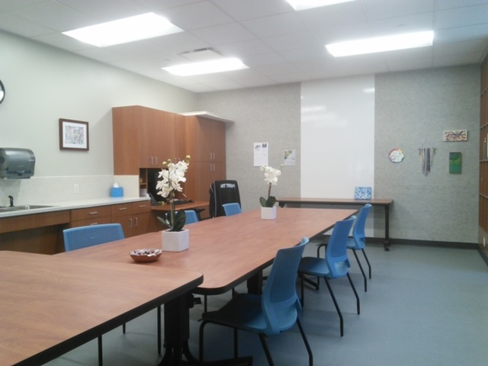
Art Therapy Studio- Day One

Slide 50
Art Therapy Studio Today

Slide 51
After the dust settled
The Creative Therapy Centers and Healing Gardens is the most used area
Staff loves it too!
Other named areas were funded and dedicated over the next 6-18 months
$1 million endowment fund created and funded within 15 months

Slide 52
Next we launched the Creative Therapies Endowment Fund and raised $1.25 million to support the program expenses
Email to donors on the 1 and 5 year anniversaries
Has become the crown jewel of the hospital

Slide 53
Donor Recognition Moves Inside
Consistent policy for donor recognition created and followed throughout the hospital
Same style of donor recognition plaques used throughout the hospital

Slide 54
Consistent Donor Recognition

Slide 55
Since it opened
Hospital renovated & Believe in a Way Back naming campaign was born in 2019 and raised $750,000 for named areas
Spirituality Center now doubles as a Music Therapy studio
Patient Resource Center became our offices
Still going strong 6 years later

Slide 56
How it raised our bar
Improved relationships with donors
Built pride among board and staff
Increased funds raised each year since then

Slide 57
The personal impact
Raised the bar for my career
Great sense of personal satisfaction
One more piece of my legacy at Magee

Slide 58
Recap- How to do it right the 1st time
You have to be ready and have donors ready to give
The project has to be right- this had something for everyone
People need to be able to clearly see, feel, and understand the impact it will make
It has to be exciting

Slide 59
more of how to do it right…
Volunteers have to lead, give, and get
Donor recognition plan helped us to raise more $$$
Stay in touch as the campaign is progressing
Celebrate success
It doesn’t end when it ends- the whole process just starts over again!

Slide 60
Enabled moments like this to happen

Slide 61
Multiple gardens

Slide 62
Windows to the City

Slide 63
Duffy Avenue

Slide 64
Water Feature (not a great idea)

Slide 65
Segal Street

Slide 66
The Greenhouse

Slide 67
Patient Social Center

Slide 70
Reach out if I can help…
Mark Chilutti, CFRE
Magee Rehab Hospital- Jefferson Health
Mark.Chilutti@Jefferson.edu

